Slide 1
Multiqueue & Linux Networking
  Robert Olsson
  UU/KTH

Slide 2
Over 10 years in production
  Three major installations
  UU core routers towards SUNET
  UU Student Network 30.000 students
  ftp.sunet.se

Slide 3
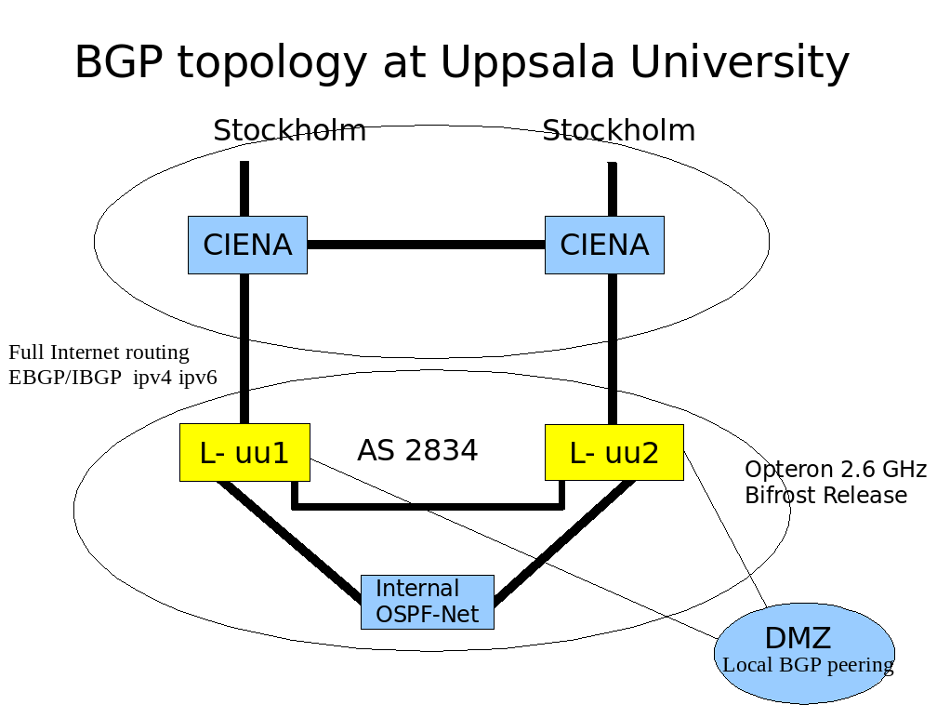
Over 10 years in production

Slide 4
Over 10 years in production
The SUNET FTP ARCHIVE
AS1653
DMZ
Juniper
Juniper
Full Internet routing
IPv4, IPv6
Bifrost
LINUX
Bifrost
LINUX
AS15980
Router discovery
IRDP
ftp
ftp
ftp
ftp
10TB

Slide 5
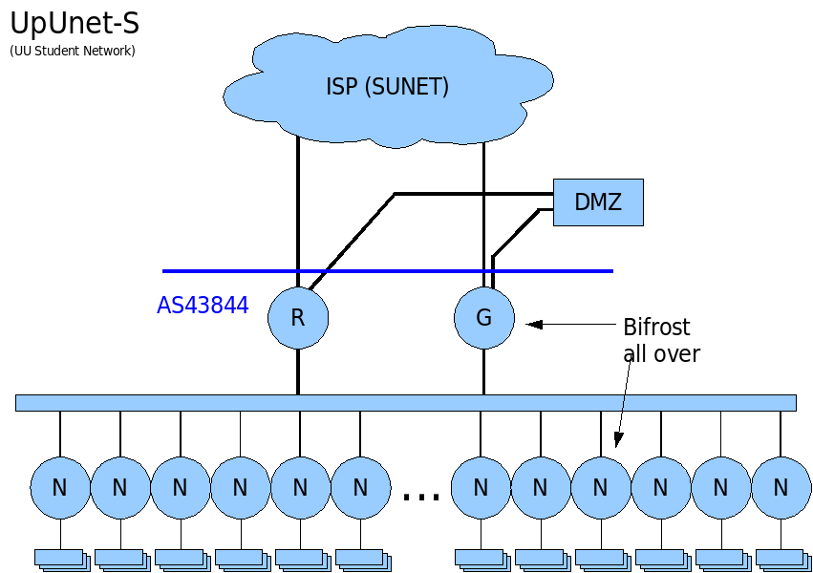
Over 10 years in production

Slide 6
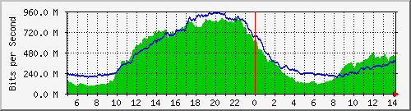
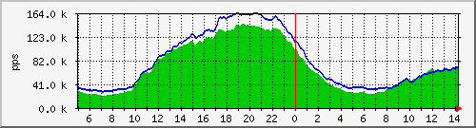
Over 10 years in production
Student Network Core Router

Slide 7
Projects/activities
Open Source
10g networking. IIS funded
Multiqueue networking. IIS funded
KTH/CSN African NREN
Stockholm/Video Conference. 10G
AVR microcontroller hacking
Solar Power of Sensor Network
Hardware/Software evaluation for networking

Slide 8
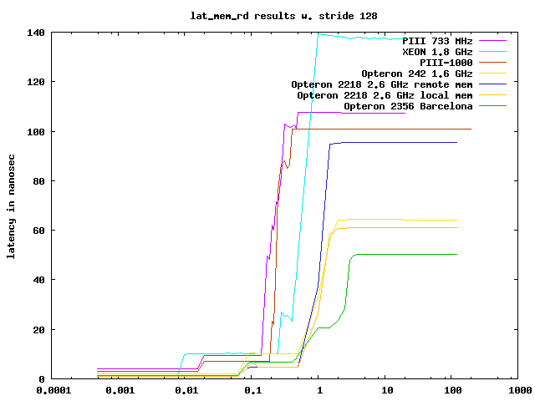
Memory Latency lat_mem_rd from LMbench

Slide 9
Multi-Q
Memory allocation per node/CPU
  NUMA stuff / SLUB vs SLAB
Classifier
  NDIS 6.0 or better on every card
XFP/SFP+ optical PHY modules

Slide 10
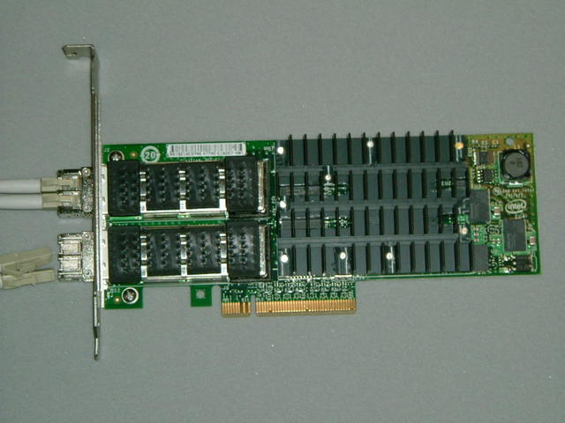
Latest & Greatest Hardware
Intel 10g board Chipset 82598
Open chip specs. Thanks Intel!
But why fixed XFP's??
Better classifier needed.

Slide 11
Block hw structure

Slide 12
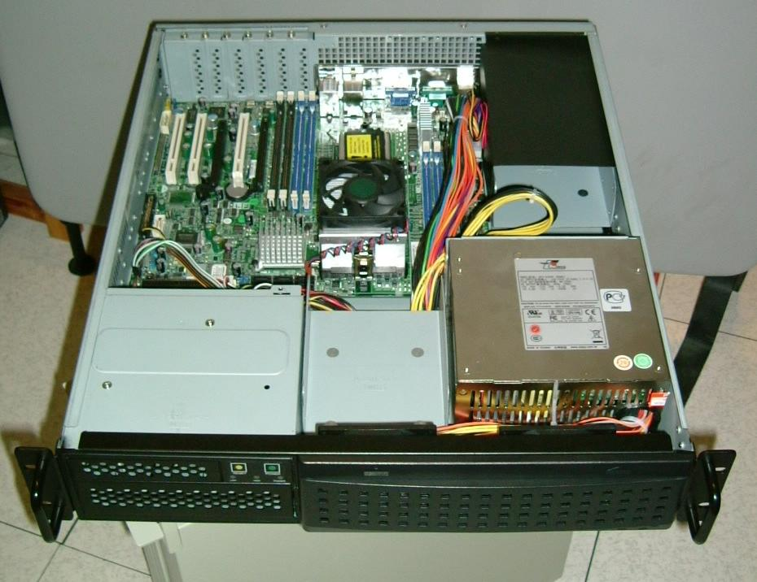
Hardware
  AMD Opteron 2356 with one quad core 2.3GHz Barcelona
  CPUs on a TYAN 2927 Motherboard (2U)

Slide 13
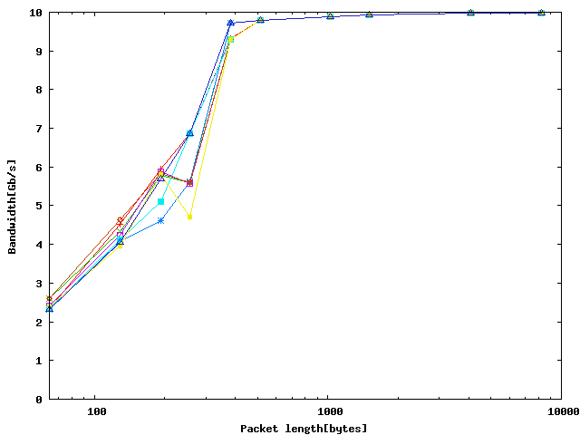
Tx single sender: Bandwidth

Slide 14
Fully parallel router concept multi-queue breakthrough
  In experiment we used Intel 82598 adapters.
  Intel follows MS NDIS 6.0 for virtualization
  SUN's 10g board has a more potent HW classifier
  aka TCAM.
  Potent classifiers can give a breakthrough for both functions and performance.
  Control plane separation, (routing daemons)
  QoS, filters etc.

Slide 15
Multi-Q routing experiments
NIC classification (Receiver Side Scaling RSS) uses hash algorithm to select input queue
Allocate several interrupt channels, one for each CPU.
Flows are distributed evenly between CPUs
  need aggregated traffic with multiple flows
Questions:
  Are flows evenly distributed?
  Will performance increase as CPUs are added?Use more CPU cores to handle forwarding

Slide 16
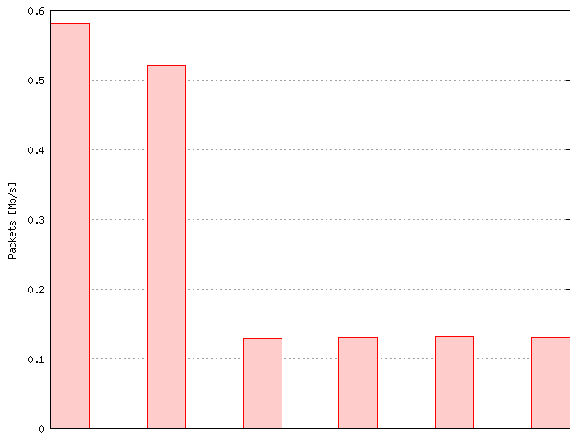
Multi-flow and Multi-CPU
TX lock contention
1 CPU 4 CPUs CPU #1 CPU #2 CPU #3 CPU #4
Only 64 byte packets

Slide 17
Fully parallel router multi-queue breakthrough
  Flow load. 31.000 fib_lookups/sec
  BGP table w. 271.064 routes
  Different 3 packet sizes
  64 bytes 45%
  576 bytes 25%
  1500 bytes 30%
  RSS and Multi-Queue (RX and TX) in use
  Linux 2.6.27-rc2 ixgbe-1.3.31.5 + patches
  Using 2/4 CPU cores from AMD Barcelona 2.3 GHz
  Forwarding:: 6.2 Gbit/s (960 kpps)

Slide 18
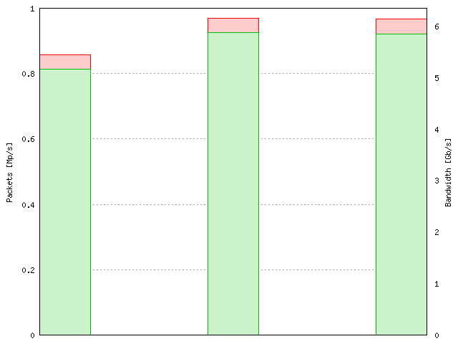
Multi-flow and Multi-CPU (set 2)
1 CPU 2 CPUs 4 CPUs

Slide 19

A new network symbol has been seen...
The Penguin Has Landed

Slide 20
Trash data-structure
  Interesting novel approach. Trie-Hash --> Trash
  When extending the LC-trie
  Paper with Stefan Nilsson/KTH
  Exploits that key-length does not affect tree depth
  We lengthen the so key it can be better compressed.
  Implemented in Linux forwarding patch as a
  replacement to the route hash.

Slide 21
Trash data-structure
  Can do full key lookup. src/dst/sport/dport/proto/if
  etc and later socket.
  For even ip6 with little performance degradation
  Could be a candidate for the grand unified lookup
  Full flow lookup can understand connections.
  Free flow logging etc
  New garbage collection (GC) possible. Active GC stated
  AGC in the paper. Listen to TCP SYN, FIN and RST
  Show to be performance winner.

Slide 22
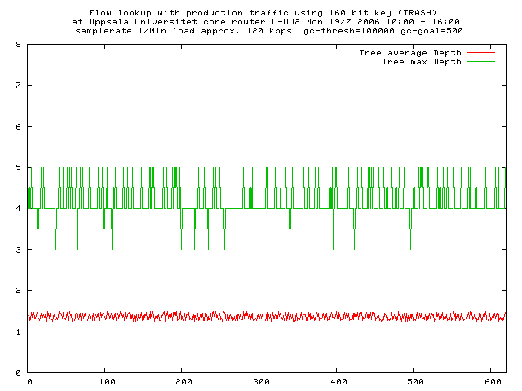
Trash data-structure
Uppsala Universitet core router

Slide 23
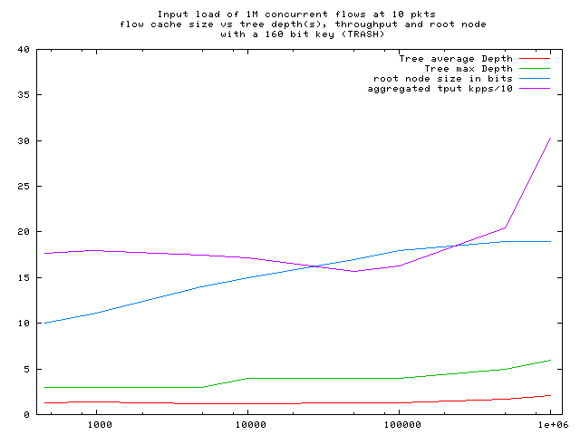
Trash data-structure
Very flat(fast) trees

